Slide 1

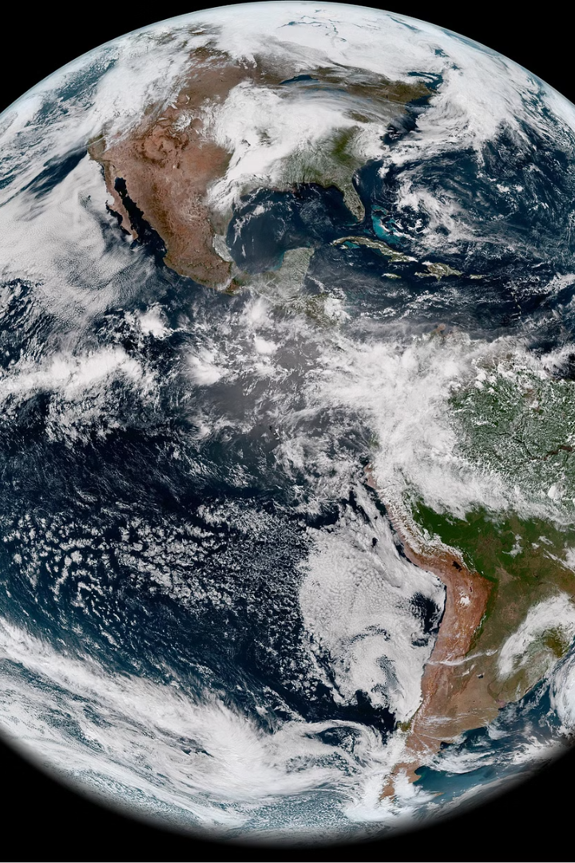
Industrial Site Analysis
Name : KONDETI VENKAT
Roll No. : S20210010125

Slide 2
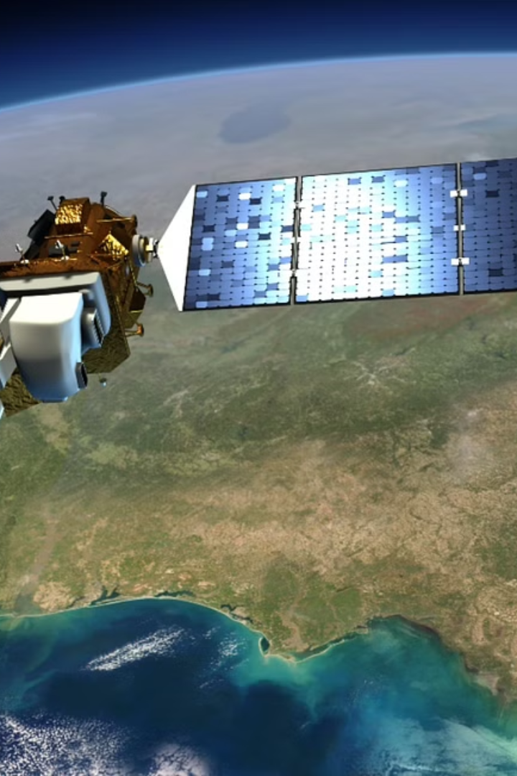
Aim of the Project
The aim of an industrial site analysis project is to identify and evaluate potential locations for industrial development, ensuring optimal site selection based on various factors such as infrastructure availability, transportation access, environmental considerations, regulatory compliance, and socioeconomic impact. The project aims to provide stakeholders with comprehensive insights into suitable industrial sites, facilitating informed decision-making and sustainable development practices. Through geospatial analysis and data-driven methodologies.

Slide 3
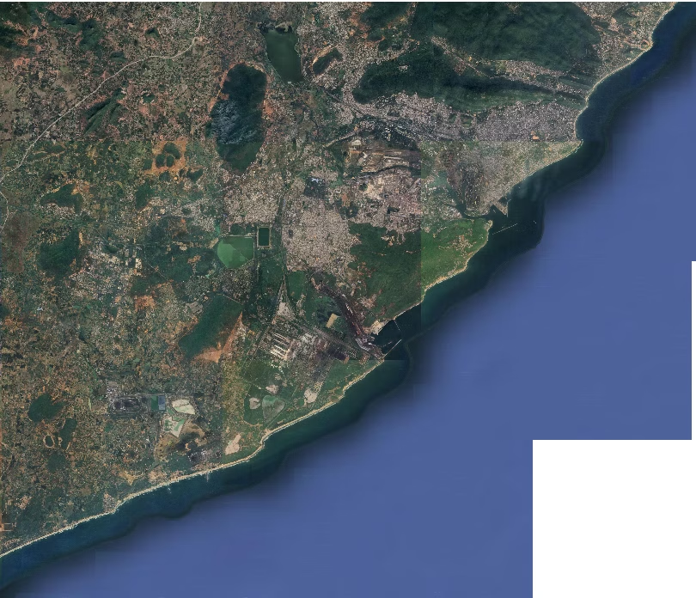
Satellite Image

Slide 4
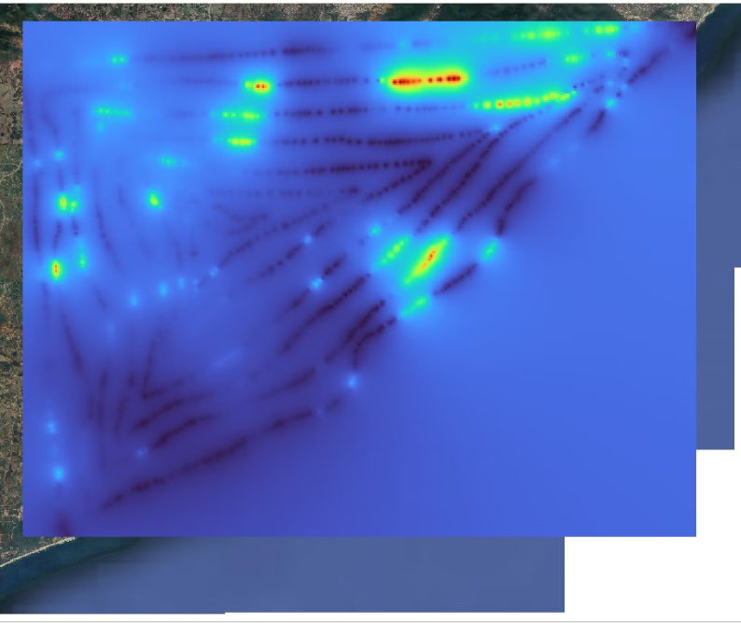
Raster Data Analysis
Digital Elevation Model (DEM)

Slide 5
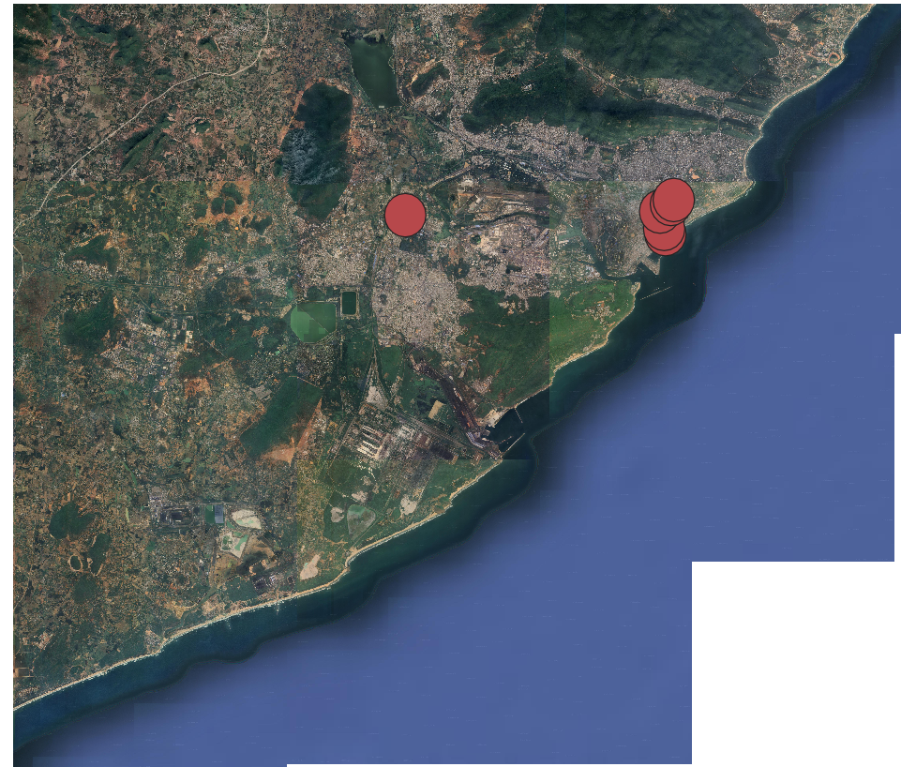
Buffered images
Hospitals

Slide 6
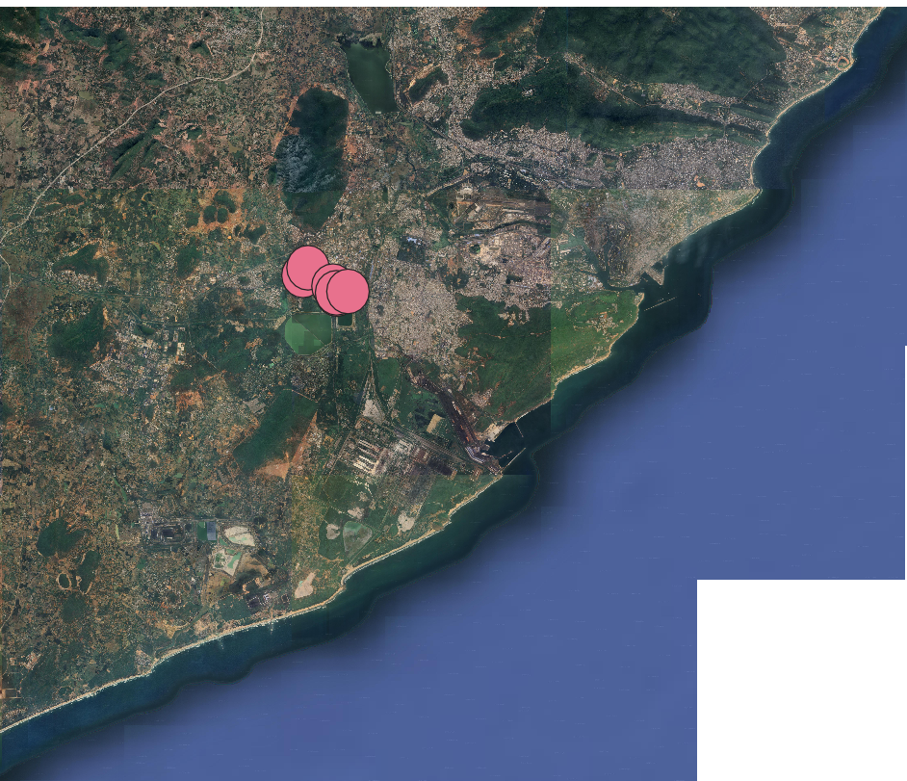
Buffered images
2. Shopping Complexes

Slide 7
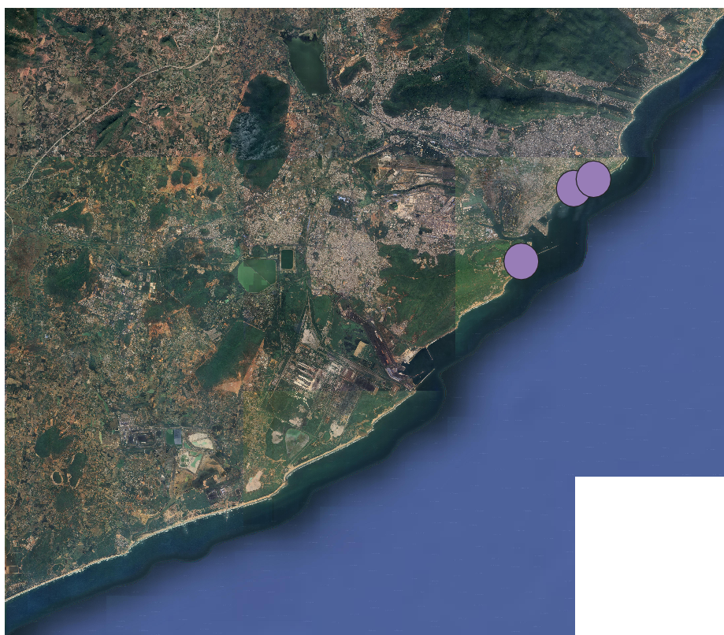
Buffered images
3.Tourism

Slide 8
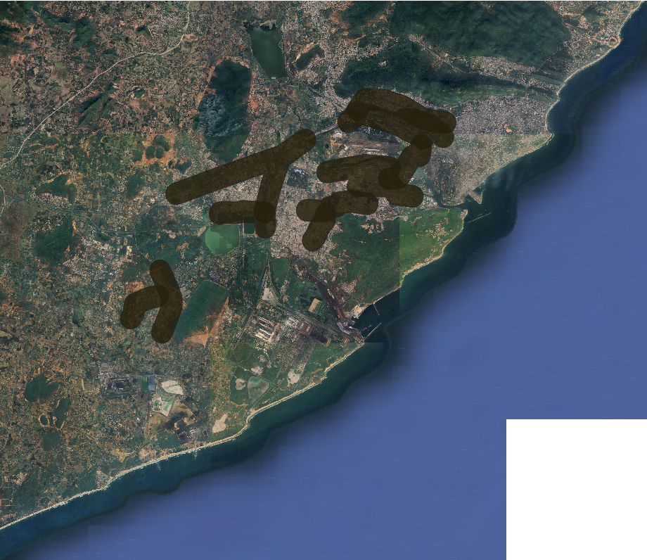
Buffered images
4.Road Ways

Slide 9
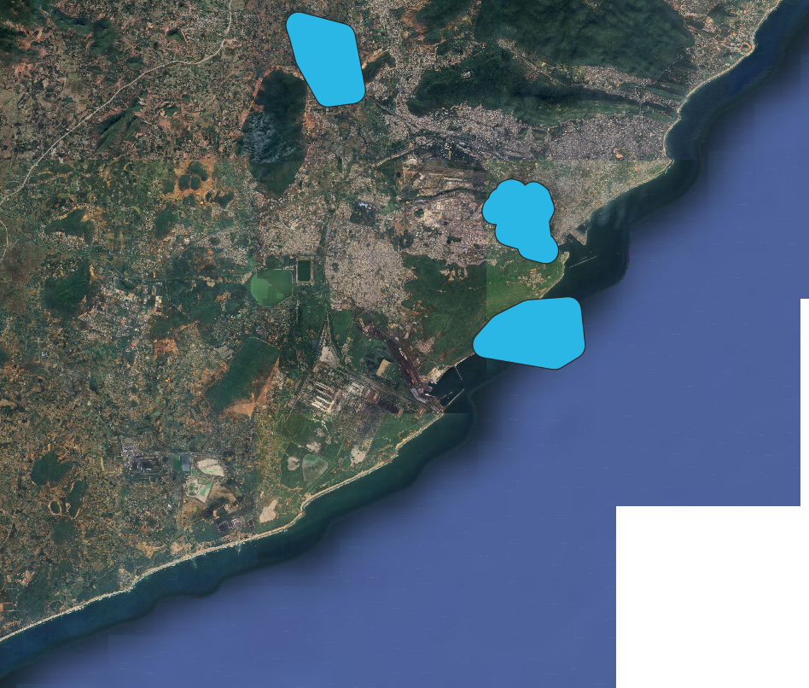
Buffered images
5.Water Bodies

Slide 10
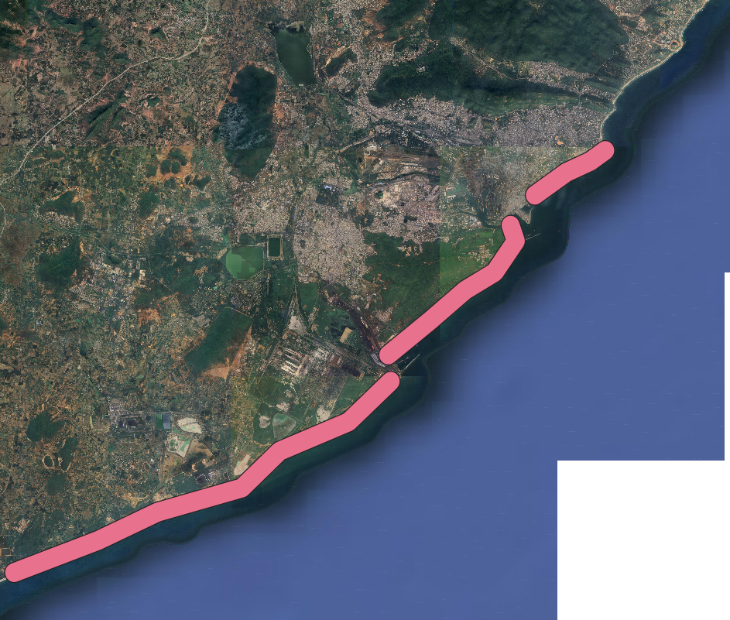
Buffered images
6.Coastle Buffer

Slide 11
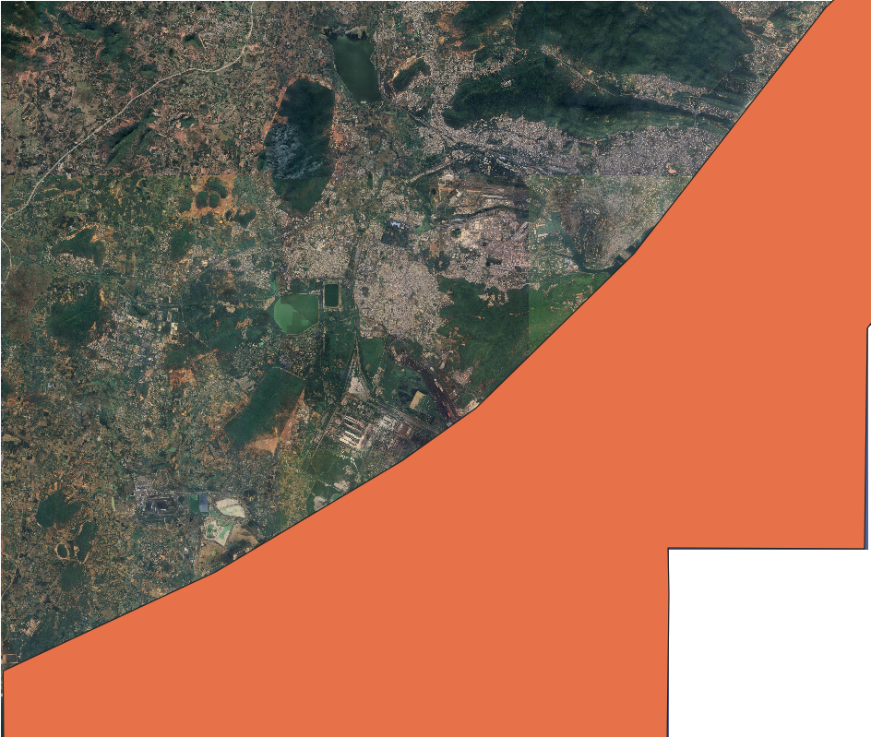
Buffered image using Clip Operation
7.Sea Buffer

Slide 12
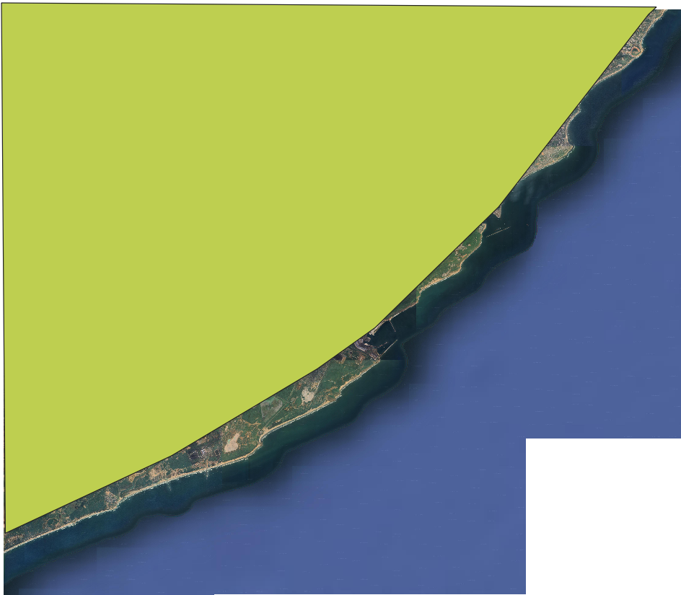
Clip Operation
Non sea Buffer

Slide 13
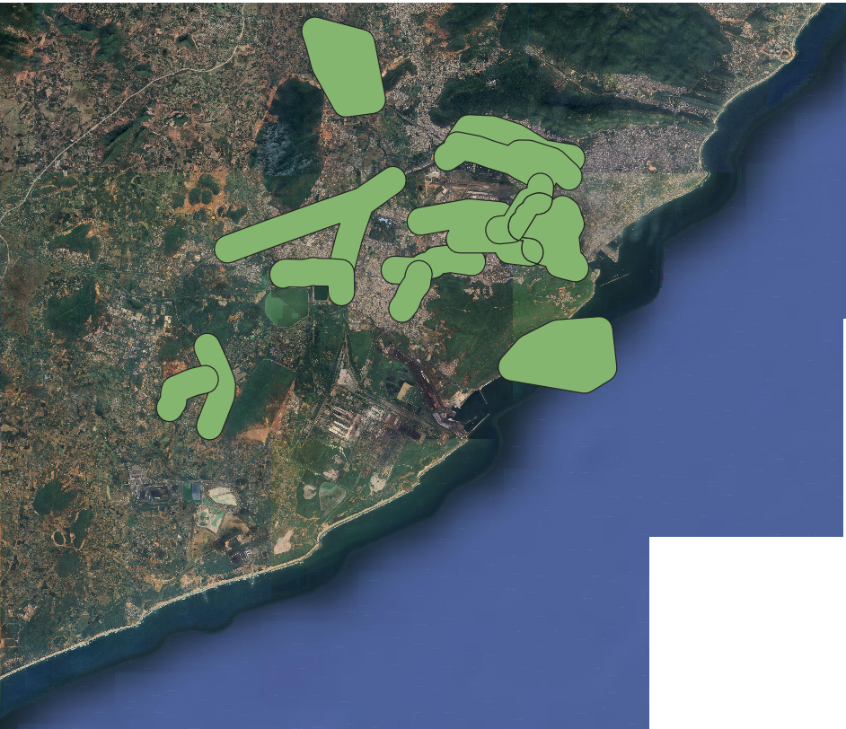
Union Operation of Road And Water

Slide 14
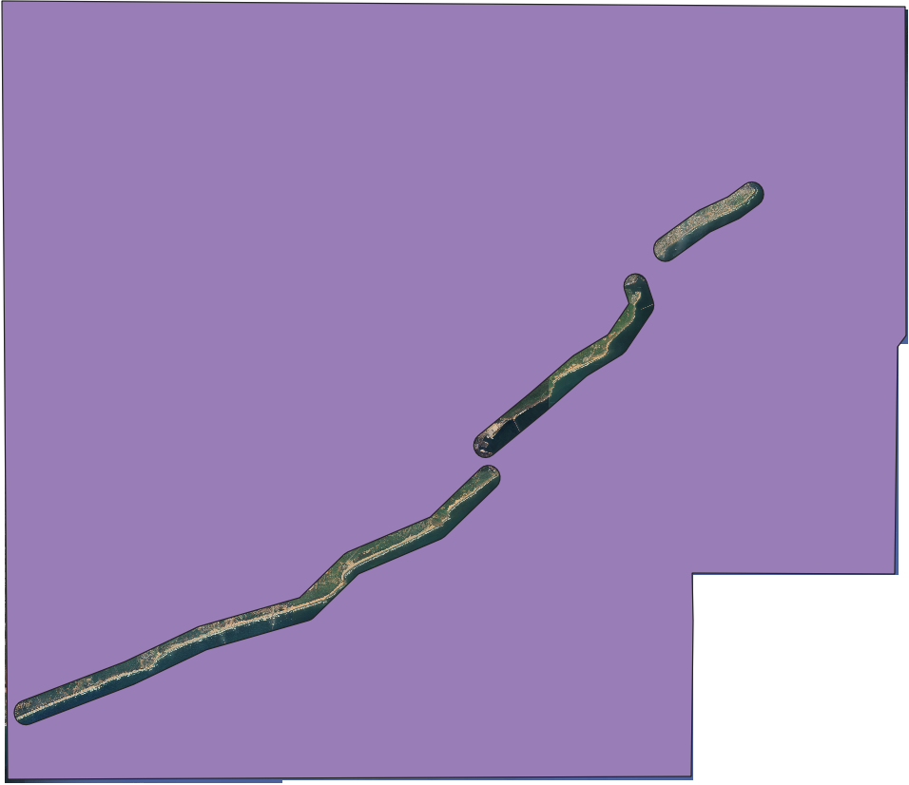
Difference Operation on Coastle and Boundary

Slide 15
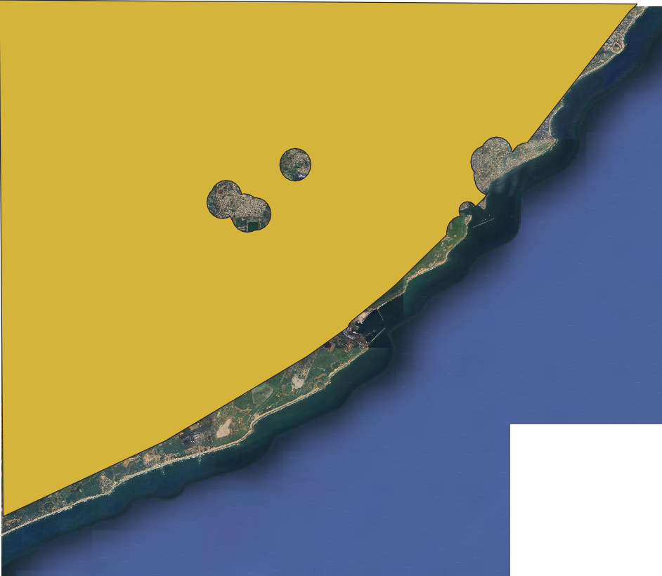
Difference Operation on Coastle and Union Of Hospital Shopping Tourism

Slide 16
We can built an industry in this area

Slide 17
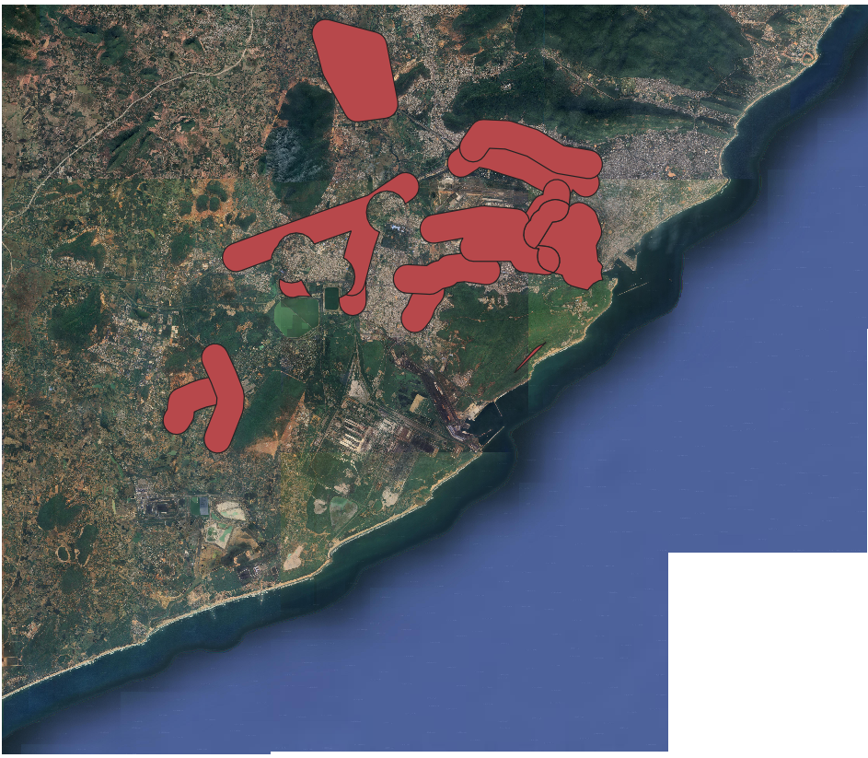
Final Output
Intersection Operation

Slide 18
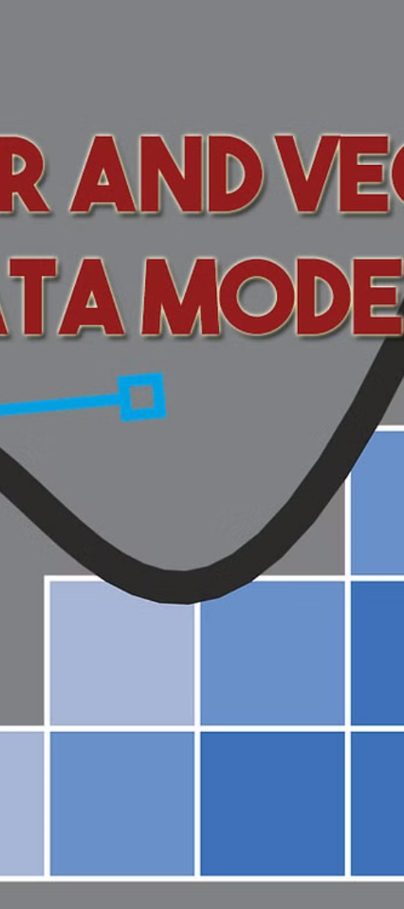



Vector Data Analysis
Data Extraction
We will extract relevant vector data from the satellite image, such as road networks, administrative boundaries, or land parcel information, to supplement our analysis.
Spatial Relationships
Analyzing the vector data in conjunction with the raster information will allow us to explore the spatial relationships between different features and elements within the study area.
Overlay and Integration
By overlaying and integrating the vector data with the raster data, we can gain a more comprehensive understanding of the landscape and identify key patterns, trends, and opportunities.

Slide 19

Thank You….

